Slide 1
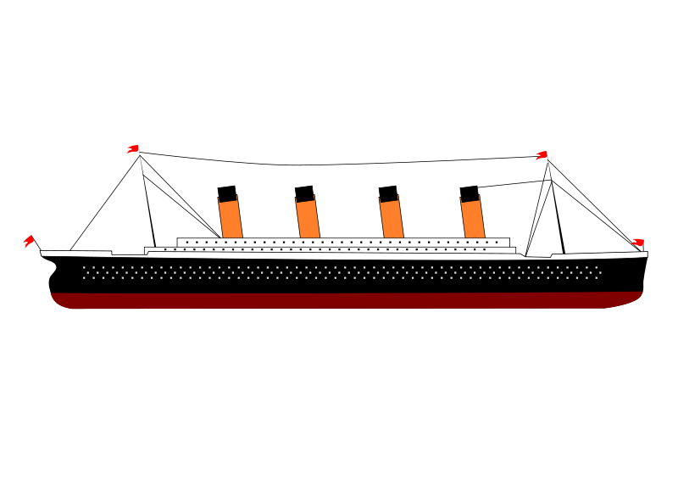
Titanic
Group 1- Children of Jupyter
Cullin Flynn, Christine Kitchens, Erika Lewars, Rick Sadowski, Kira Livingston

Slide 2


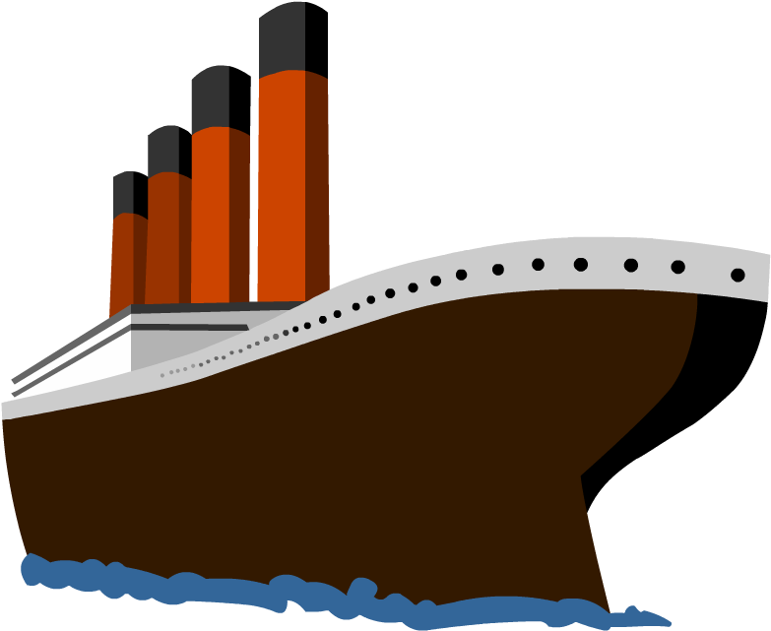







Slide 3
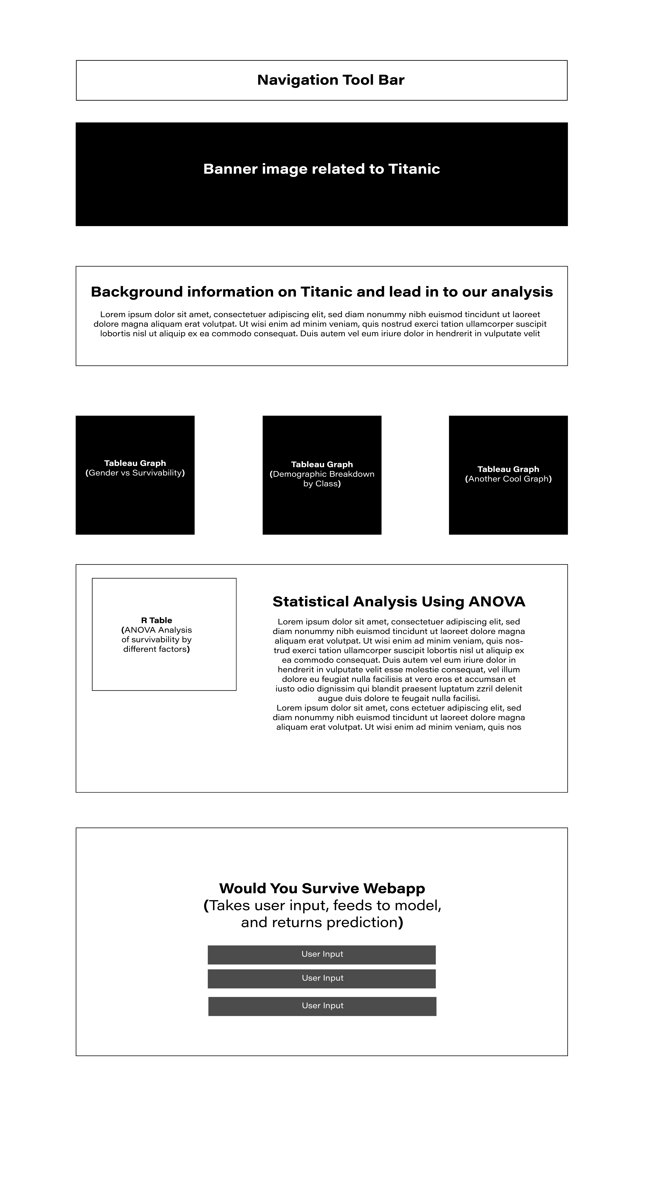
Storyboard

Slide 4
Reason that we chose to explore Titanic Data

Slide 5
Questions we hope to answer with Data

Slide 6

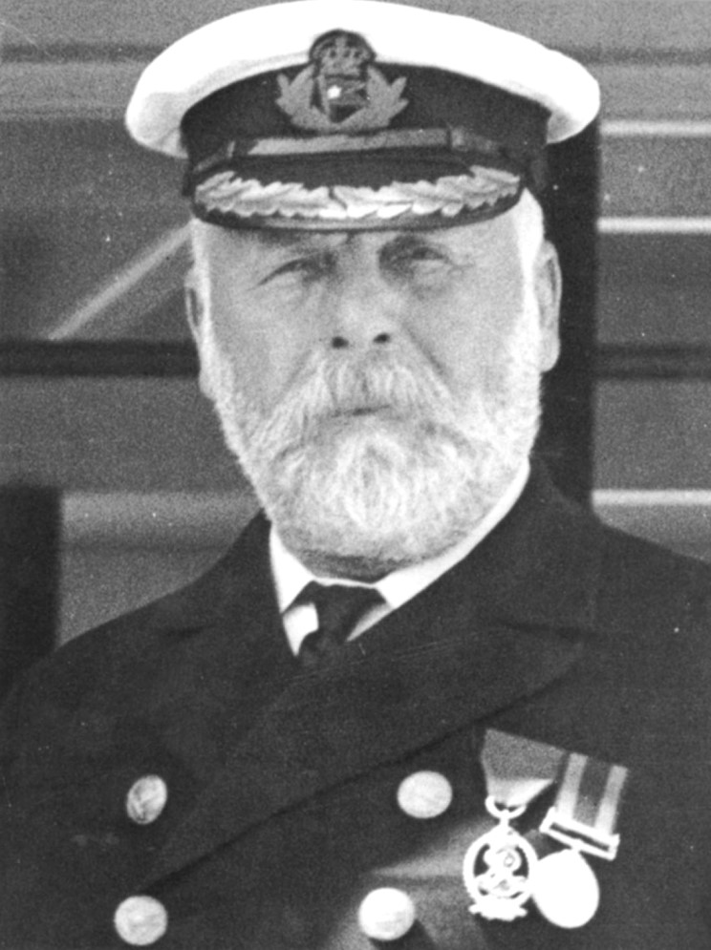
DataSource
Description of Data Source

Slide 7
Description of the data exploration phase of the project

Slide 8
Description of the analysis phase of the project.

Slide 9

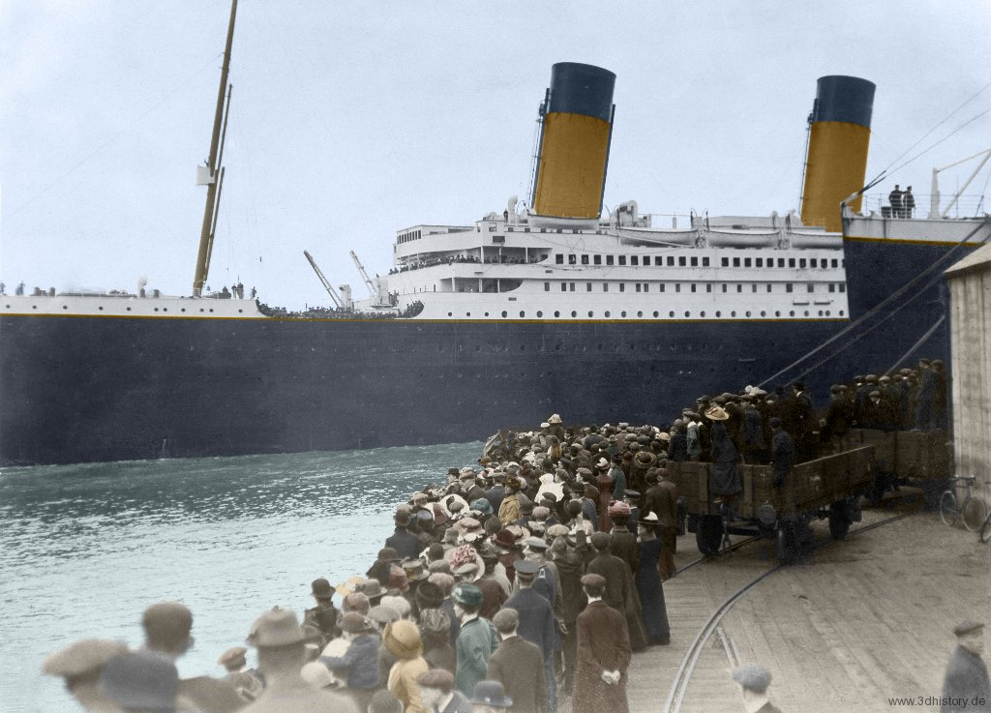
The RMS Titanic was an iconic, heralded passenger liner that sunk over the North Atlantic ocean on April 15, 1912. When the ship - which weighed over 100 million pounds and was the largest in the world at the time - met its fate, over 68% of the passengers and crew perished; however, over 700 of the two-thousand-plus passengers were saved and survived the wreck. Survival depended on many factors, but some factors may have influenced survival more than others. Below, create a fictional character on the Titanic ship, and based on information such as class, sex, and more find out if our unique model predicts that you would have survived or perished if you were on the Titanic's ill-fated maiden voyage!

